Slide 1
TensorFlow Tutorials
Kishan KC
Oct 10, 2018
Slides compiled from
CS 20: TensorFlow for Deep Learning Research
Stanford University

Slide 2
What’s TensorFlow?
Open source software library for numerical computation using data flow graphs
Developed by Google Brain
Provides primitives for defining functions on tensors and automatically computing their derivatives
Notes:
TensorFlow was originally created by Google as an internal machine learning tool, but an implementation of it was open sourced under the Apache 2.0 License in November 2015. Notice that we say an implementation and not TensorFlow was open sourced. Google still maintains its own internal implementation of it. For the rest of this course, when we say TensorFlow, we are referring to the open source implementation.

Slide 3
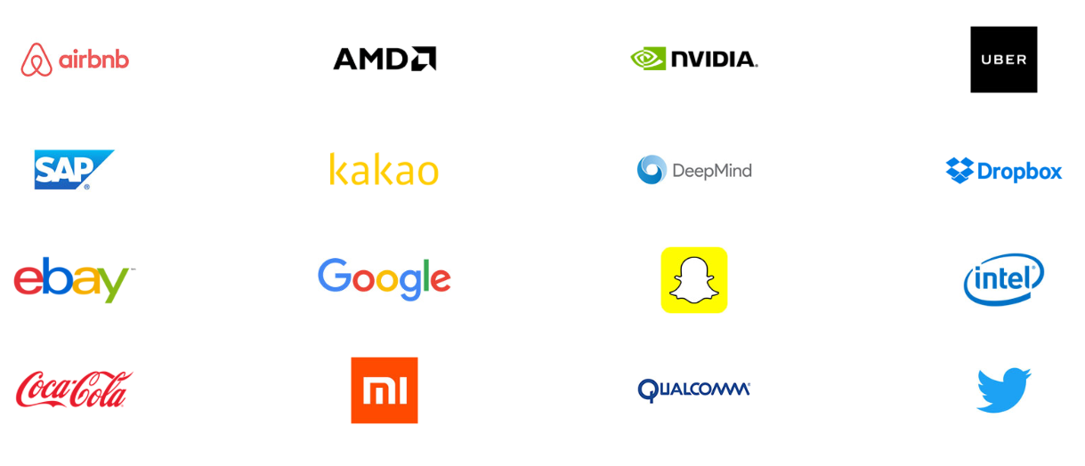
Companies using TensorFlow
From https://www.tensorflow.org

Slide 4
The programming stack

Slide 5
Goals
Understand TF’s computation graph approach
Explore TF’s built-in functions and classes
Learn how to build and structure models best suited for a deep learning project

Slide 6
Getting Started

Slide 7
Tensor
Generalization of vectors and matrices to higher dimensions
TensorFlow represents tensors as n-dimensional arrays of base datatypes
A tf.Tensor has the following properties:
- a data type (float32, int32, or string, for example)
- a shape
Special tensors:
tf.Variable, tf.constant, tf.placeholder, tf.SparseTensor

Slide 8
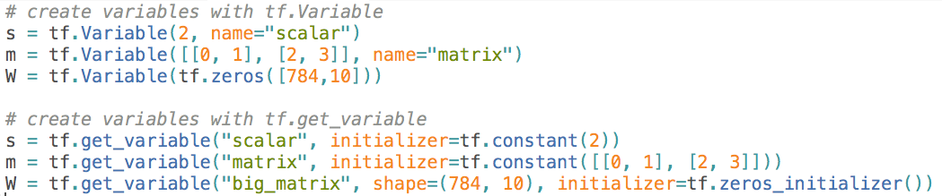
Variables
the best way to represent shared, persistent state manipulated by your program
Variables are manipulated via the tf.Variable class
Variable is basically a wrapper on tensor that maintains states across multiple calls to run
Example:

Slide 9
Initialize your variables
The easiest way is initializing all variables at once:
Initialize only a subset of variables:

Slide 10

Graphs and Sessions
From https://www.tensorflow.org

Slide 11
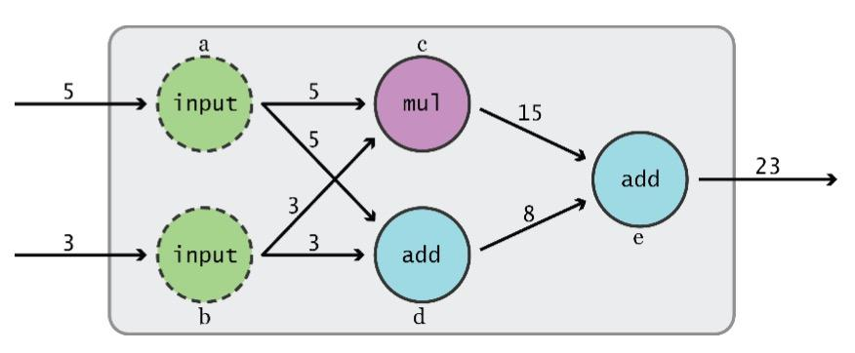
Data Flow Graphs
Dataflow: programming model for parallel programming
TensorFlow separates definition of computations from their execution
Graph from TensorFlow for Machine Intelligence
Notes:
How does it do so? By using graphs and sessions

Slide 12
Data Flow Graphs
Phase 1: assemble a graph
Phase 2: use a session to execute operations in the graph
Graph from TensorFlow for Machine Intelligence

Slide 13
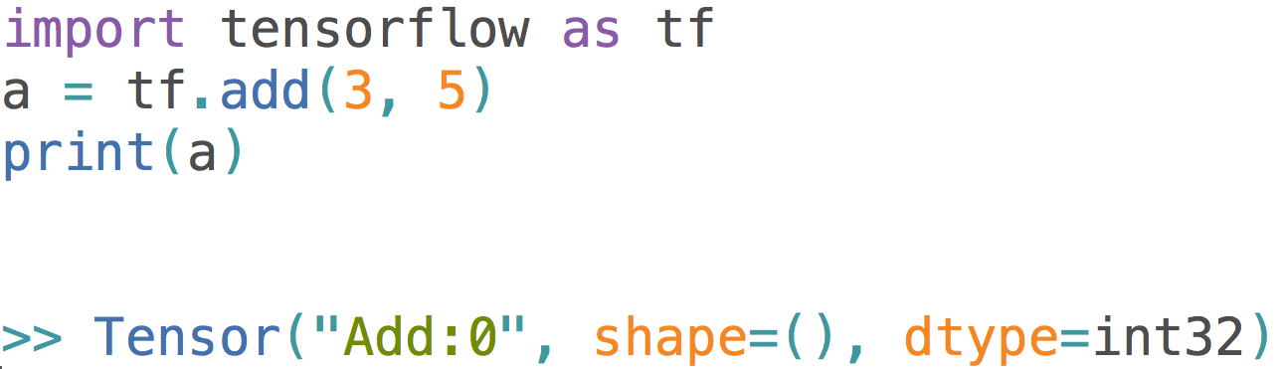
Data Flow Graphs
What will it print?
Not 8, why??

Slide 14
How to get the value of a?
Create a session, assign it to variable sess so we can call it later
Within the session, evaluate the graph to fetch the value of a
What is session?

Slide 15
tf.Session()
Encapsulates the environment in which Operation objects are executed, and Tensor objects are evaluated
Allows to execute graphs or part of graphs
Allocates resources (on one or more machines) for that and holds the actual values of intermediate results and variables
Notes:
Note that sessions deal with memory allocation

Slide 16
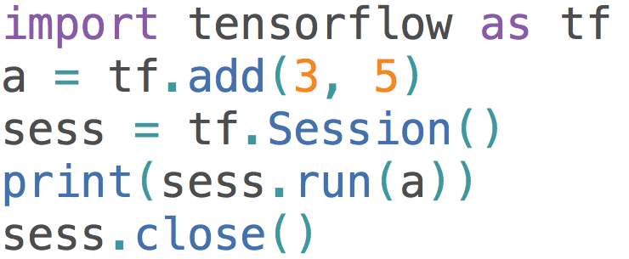
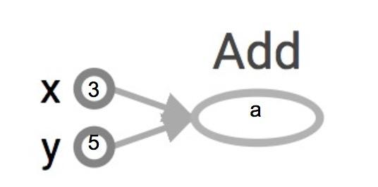
How to get the value of a?
The session will look at the graph, trying to think: hmm, how can I get the value of a,
then it computes all the nodes that leads to a.

Slide 17
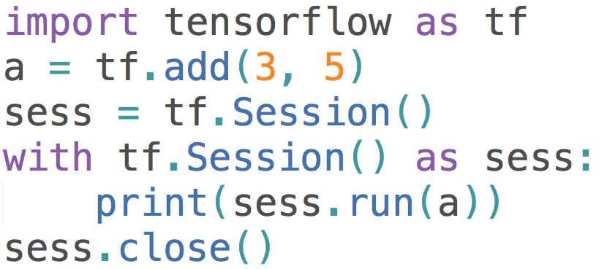
How to get the value of a?
>> 8
8
Alternative approach:
The session will look at the graph, trying to think: hmm, how can I get the value of a,
then it computes all the nodes that leads to a.

Slide 18
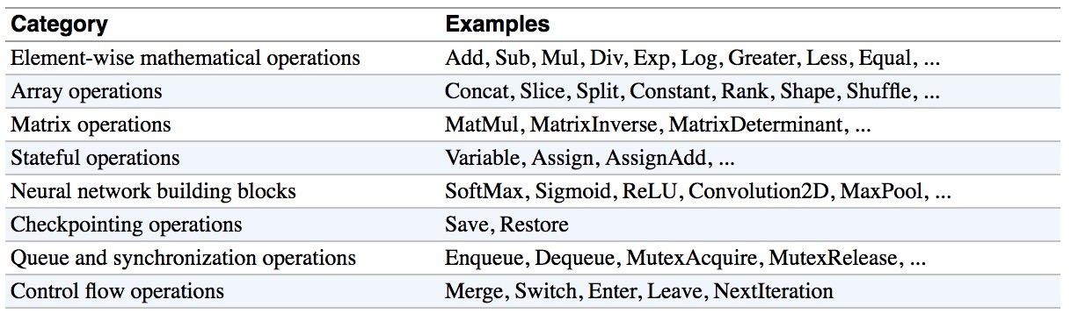
Operations
Buduma. Fundamentals of Deep Learning. O’Reilly, 2017
Notes:
Should i keep this or nah?
Not sure it adds much that isn’t already in the slides -straka

Slide 19
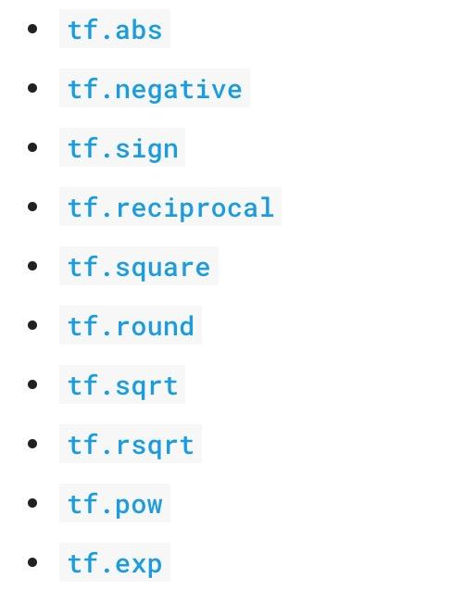
Arithmetic Ops
Pretty standard, quite similar to numpy.

Slide 20
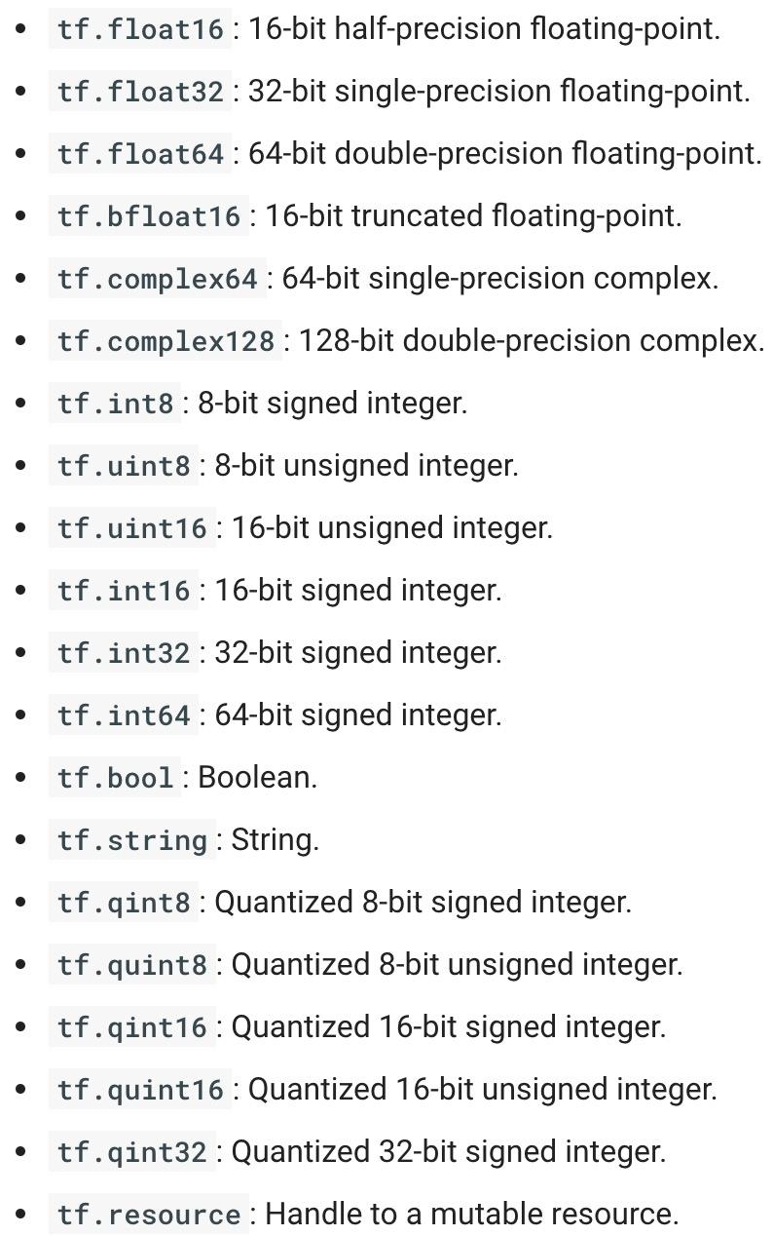
TensorFlow Data Types
Notes:
https://www.tensorflow.org/api_docs/python/tf/DType

Slide 21
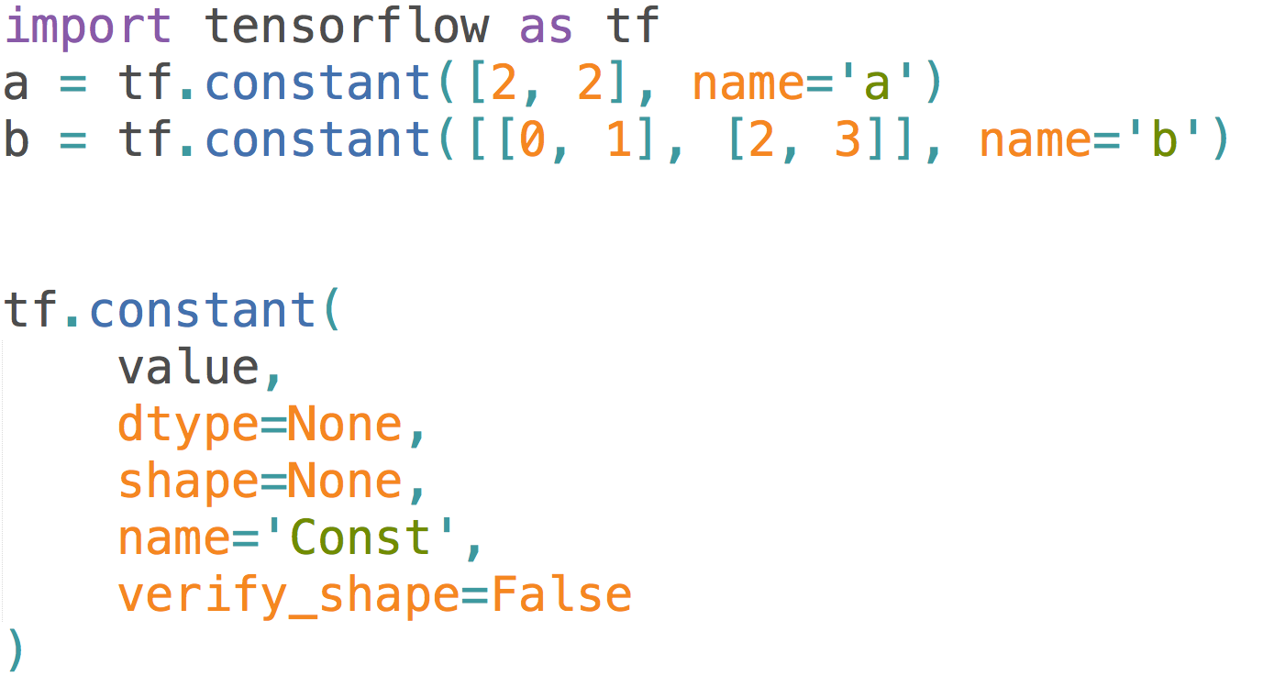
Constants

Slide 22
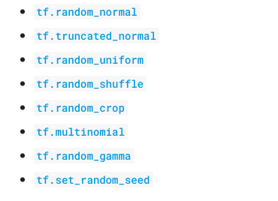
Randomly Generated Constants
TF has several ops that create random tensors with different distributions
the initialization of variables
Notes:
You’ll often see use of tf.truncated_normal() instead of tf.random_normal(), as it doesn’t create any values more than two standard deviations away from its mean.

Slide 23
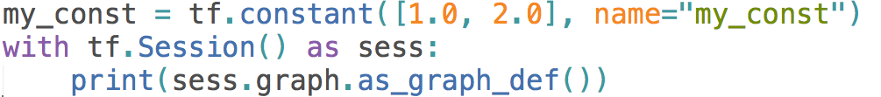
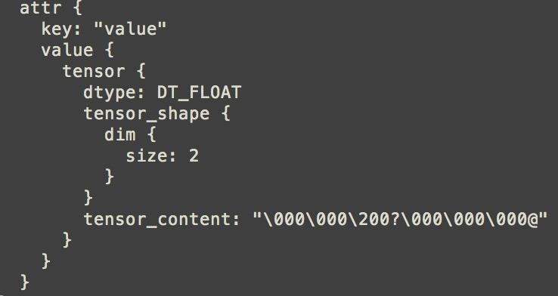
What’s wrong with constants?
Constants are stored in the graph definition
This makes loading graphs expensive when constants are big
Only use constants for primitive types.
Use variables or readers for more data that requires more memory

Slide 24
Placeholders
A quick reminder: A TF program often has 2 phases:
Assemble a graph
Use a session to execute operations in the graph
⇒ Assemble the graph first without knowing the values needed for computation
Analogy:
Define the function f(x, y) = 2 * x + y without knowing value of x or y.
x, y are placeholders for the actual values.

Slide 25
Why placeholders?
We, or our clients, can later supply their own data when they need to execute the computation.

Slide 26
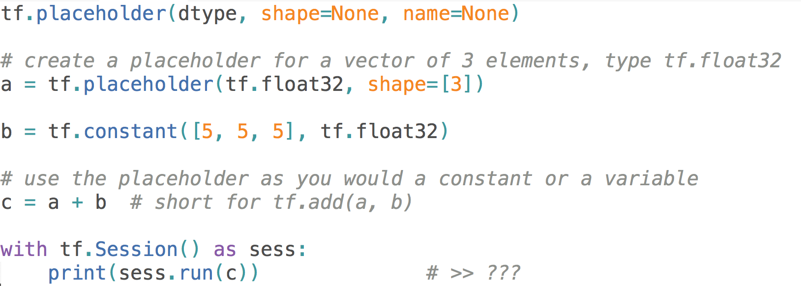
Placeholders: Example
Syntax
# >> Error (??)

Slide 27
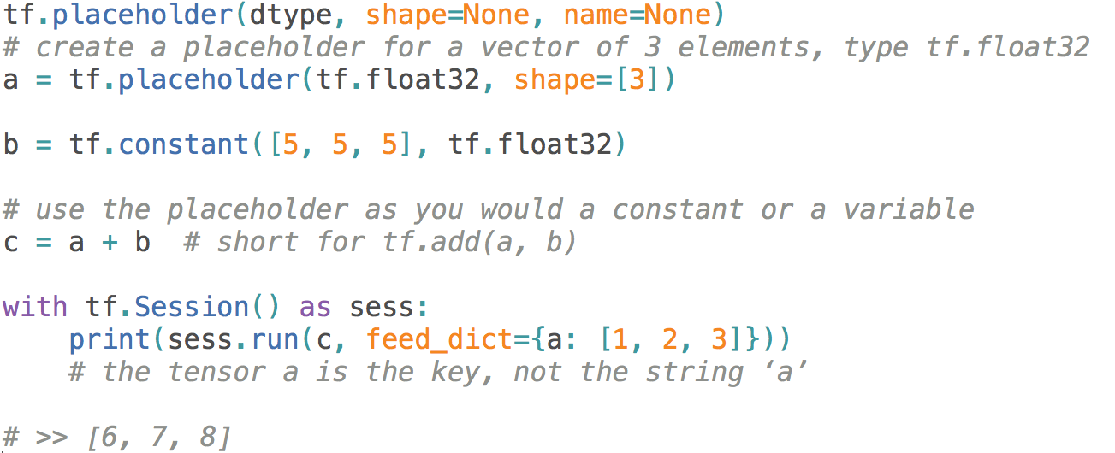
Placeholders: Example
Solution: Supplement the values to placeholders using a dictionary
Syntax

Slide 28
You can feed_dict any feedable tensor.
Placeholder is just a way to indicate that something must be fed

Slide 29
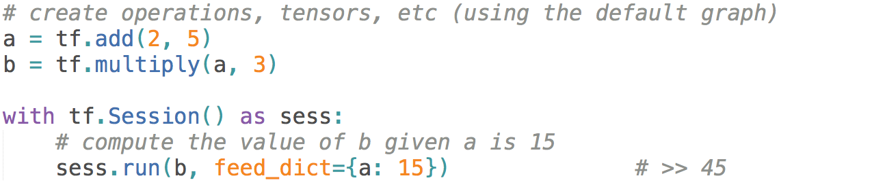
Feeding values to TF ops
We can evaluate TF operations individually as well.
Notes:
The session will look at the graph, trying to think: hmm, how can I get the value of a, then it computes all the nodes that leads to a.

Slide 30
Extremely helpful for testing
Feed in dummy values to test parts of a large graph
Notes:
When you have a large graph and just want to test out certain parts, you can provide dummy values so TensorFlow won’t waste time doing unnecessary computations.

Slide 31
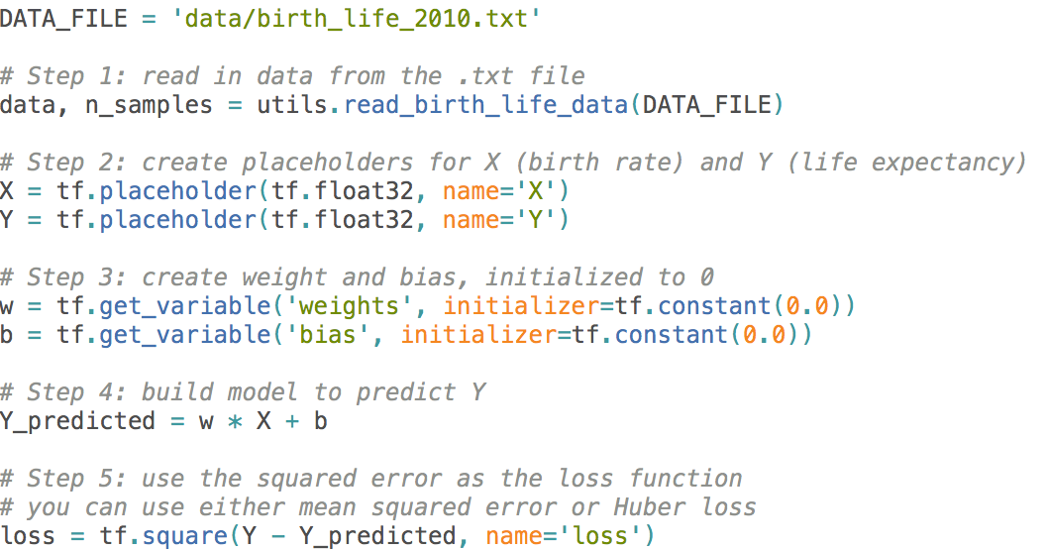
Putting it together
How does TensorFlow know what variables to update?
Notes:
Example from GitHub

Slide 32
Optimizers
Session looks at all trainable variables that optimizer depends on and update them
Specify if a variable should be trained or not
By default, all variables are trainable
tf.Variable(initial_value=None, trainable=True,...)
Add a optimizer to the program

Slide 33
Linear Regression
Dataset : World Development Indicators dataset
Target: Find a linear relationship between X and Y to predict Y from X
Model:
Inference: Y_predicted = w * X + b
Mean squared error: E[(y - y_predicted)²]
Lets execute the program

Slide 34
Logistic Regression
Dataset : Mnist Dataset
Target: Recognize the digit in the image
Model:
Inference: Y_predicted = softmax(X * w + b)
Cross entropy loss : -log(Y_predicted)
Lets execute the program

Slide 35

Resources
Get Started with TensorFlow (https://www.tensorflow.org/tutorials/)
Google Colab: An easy way to learn and use TensorFlow
- hosted Jupyter notebook environment that is free to use and requires no setup
CS 20: Tensorflow for Deep Learning Research (http://web.stanford.edu/class/cs20si/)
Model Zoo Tensorflow (https://modelzoo.co/framework/tensorflow)
For mobile and web developer

Slide 36
Questions
Email me: kk3671@rit.edu
Visit me in my lab 74-1050
Thanks

